Slide 1
brightspeed
Billing taxonomy and YTD classification
Executive decision package for operating and financial leadership
832,885
10 + 1
104
91.4%
YTD billing contacts classified
macro categories plus fallback
canonical billing reasons
classified to a specific topic
October 2026 readiness view
Notes:
[Sources]
Business_Overview.md: counts for raw contacts, billing contacts, 10+1 categories, 104 tags and 91.4% specific classification. Review_Response.md: YTD tagged output counts.

Slide 2
brightspeed
02
Executive synthesis: the system converts billing contact volume into managed signals
Key message: a governed vocabulary now turns billing reasons into stable reporting and action levers.
832,885
94.2%
5.8%
8.6%
104
billing rows scored
single-topic contacts
genuine multi-topic contacts
fallback rate for review
canonical leaf tags
Management implications
Topic rank distribution
Experience
Customer pain is now measurable by reason, not broad queue label.
Economics
Payment, balance, credits, fees and refunds can be tied to cost-to-serve and leakage.
Exactly 1 topic
Exactly 2 topics
3 topics
Data layer
A stable tag layer enables workflow routing, dashboards and model governance.
Interpretation: the classifier is intentionally conservative. Extra topics are exceptional, not filler.
8.6% fallback creates an auditable backlog for governance rather than forcing low-confidence labels.
Source: YTD tagged output and taxonomy report.
Notes:
[Sources]
Review_Response.md: 832,885 rows; exactly 1 topic 784,777; exactly 2 topics 45,288; 3 topics 2,820; at least a second topic 48,108; fallback 71,922. Business_Overview.md: 91.4% specific topic.

Slide 3
brightspeed
03
End-to-end process: separate discovery, governance and production scoring
The pipeline intentionally avoids treating exploratory clusters as final business labels.
1
2
3
4
5
YTD contacts
Billing segment
Topic discovery
Governed taxonomy
YTD scoring
5.0M+ call population context
832,885 Billing / Payments rows
12 categories / 40 fine clusters
10 macro categories + Other; 104 leaves
tag_1 required; tag_2/3 only when separate
Critical distinction
The 40 clusters were a discovery resolution. The 104 leaves are the controlled production vocabulary.
Why this matters: rare but valid billing intents would disappear if the taxonomy were limited to high-density clusters only.
Source: technical process report and final taxonomy workbook.
Notes:
[Sources]
Brightspeed_Billing_Taxonomy_Process_Report.md: initial explanatory notebook 12 categories / 40 fine KMeans clusters; final production ontology 10 macro categories plus Other with 104 canonical subcategories; final uploaded YTD billing workbook 832,885 rows.

Slide 4
brightspeed
04
Why 12 / 40 became 10 + 1 / 104
The category layer was simplified for executives; the leaf layer was expanded for operational coverage.
Exploratory notebook
Scale-up search
Production taxonomy
12 categories
14 coarse groups
10 + 1 categories
40 fine clusters
80 fine clusters
104 canonical leaves
Learn observed geometry
Stress-test resolution
Classify current and future asks
Governance transformations
• Merge overlapping semantic groups into durable reporting categories
• Retain rare but valid billing consequences such as vacation hold billing
• Split operationally distinct asks that clustering can blur, such as late-fee dispute versus waiver
• Freeze machine-readable canonical tags and route residual ambiguity to Other
Source: process report, taxonomy workbook and canonical vocabulary.
Notes:
[Sources]
Brightspeed_Billing_Taxonomy_Process_Report.md: 12/40 is exploratory discovery; scale-up uses 80/14 as higher-resolution engineering defaults; final 10+1/104 is governed production vocabulary. Classification prompt file contains the canonical vocabulary and exact output rules.

Slide 5
brightspeed
05
YTD billing volume is concentrated in a small number of operating themes
Payments and balance questions together account for more than half of tagged billing contacts.
Payments and Payment Posting
245k (29.4%)
Bill Understanding and Balance
225k (26.9%)
Other Category
72k (8.6%)
Payment Assistance Past Due and Collections
64k (7.7%)
Billing Errors Fees and Taxes
58k (6.9%)
Credits Refunds and Adjustments
55k (6.7%)
AutoPay and Payment Methods
51k (6.1%)
Rates Discounts and Recurring Charges
23k (2.8%)
Billing Delivery Account and Preferences
15k (1.8%)
Service Changes Equipment and Final Billing
13k (1.5%)
Promotions Rewards and Gift Cards
12k (1.5%)
Leadership readout
The initial value pool is in payment, balance and broad billing understanding; the fallback rate is the next governance target.
Source: Review_Response.md tagged output category breakdown.
Notes:
[Sources]
Review_Response.md: category breakdown top 10 plus Promotions Rewards and Gift Cards; rows and shares listed in Q2.

Slide 6
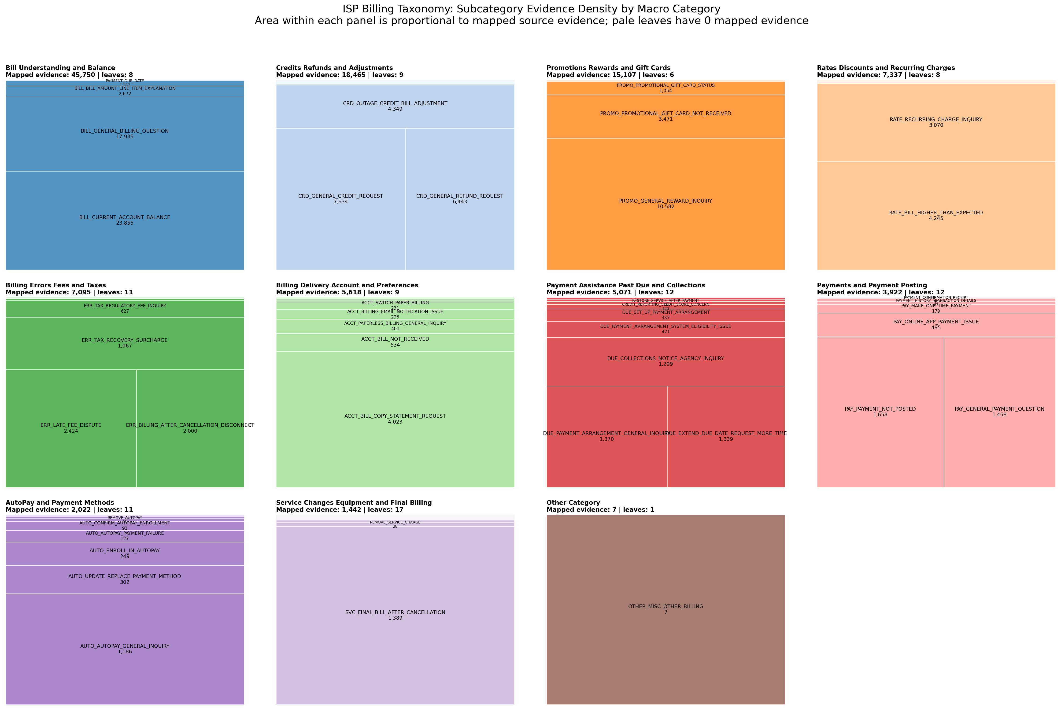
brightspeed
06
Treemap density reveals the managed reason portfolio
Area reflects mapped evidence density; low-volume coverage leaves remain visible for future classification.
How to read it
• Large blocks: high-volume observed reasons
• Small blocks: rare or coverage-expansion leaves
• Color grouping: macro category structure
• Purpose: audit coverage without deleting rare valid asks
Executive implication
Use it to focus improvement on dense pain points while preserving taxonomy coverage for low-frequency but high-severity events.
Source: treemap_subcategory_evidence_density.png and canonical evidence mapping.
Notes:
[Sources]
billing_taxonomy_comprehensive_v4/treemap_subcategory_evidence_density.png; canonical_leaf_evidence_counts.csv contains 104 tags and mapped evidence_count. Report notes this is mapped aggregate source-reason evidence, not raw row-level density.

Slide 7
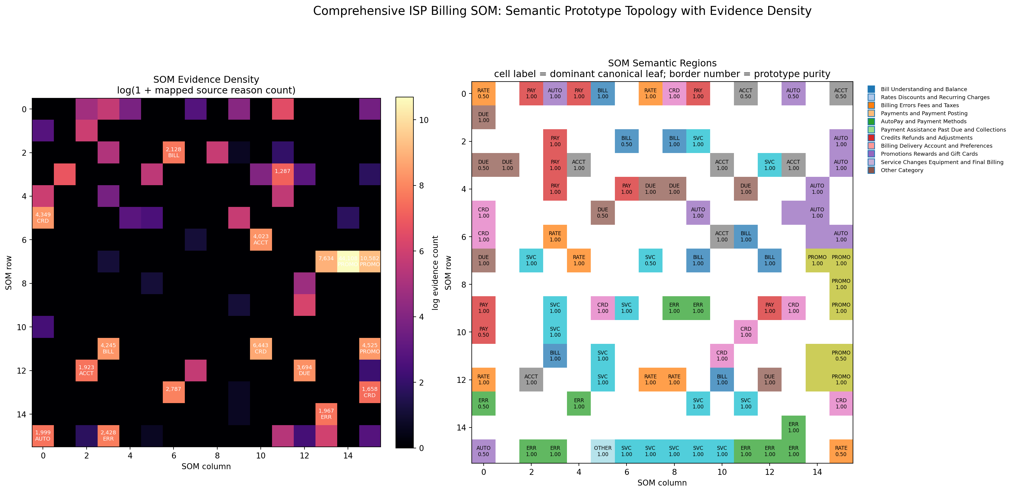
brightspeed
07
Semantic topology highlights neighborhoods, overlap and governance gaps
The SOM is a diagnostic geography of the taxonomy, not the business hierarchy itself.
What the map is useful for
• Dense regions indicate recurring semantic patterns
• Nearby regions expose likely sibling confusion
• Sparse areas identify coverage-only or rare leaves
• Outliers help find boundary leakage and candidates for Other review
Boundary condition
Current map uses semantic prototype topology with mapped evidence density; it should not be represented as raw BMU density from every YTD row.
Source: SOM evidence-density asset and technical process report.
Notes:
[Sources]
billing_taxonomy_comprehensive_v4/som_evidence_density.png; Brightspeed_Billing_Taxonomy_Process_Report.md sections 12 and 13: SOM is semantic geography, not taxonomy tree; current bundled SOM is prototype topology with mapped aggregate evidence.

Slide 8
brightspeed
08
Model architecture: discovery learns structure; governance controls outputs
The production layer prioritizes consistency, auditability and controlled vocabulary over raw cluster labels.
Segment
Discover
Validate
Control
BillingKernel
Algorithm search
GLVQ + SOM
Canonical tags
Separates billing domain from all contacts using heuristic Billing / Payments signal.
Tests KMeans, MiniBatch, Agglomerative, BIRCH and HDBSCAN where available.
Learns prototypes and surfaces semantic topology, overlap and density.
Freezes 104 allowed outputs and uses Other for ambiguous billing.
Parameter search principles
Separation
Stability
Coverage
Interpretability
Silhouette and cohesive topics
Month-to-month consistency
Few unassigned records during discovery
Centroids align with known billing concepts
Source: pipeline, clustering, GLVQ and process report artifacts.
Notes:
[Sources]
pipeline.py: stage flow includes BillingKernel, KMeans clustering, cluster-to-taxonomy mapping, GLVQ prototype model, Kohonen SOM and top-3 scoring. clustering.py: evaluates KMeans, MiniBatchKMeans, Agglomerative, BIRCH and HDBSCAN when available. Process report: algorithm search uses silhouette, coverage, month stability and seed interpretability.

Slide 9
brightspeed
09
Production scoring contract: one primary reason, optional secondary reasons
Designed to minimize entropy: no forced third tag, no invented labels, no pseudo-confidence scores.
Output discipline
Example classification logic
Customer intent
Allowed tag output
Rank use
• tag_1 is mandatory for every billing row
• tag_2 and tag_3 appear only for separate billing asks
• Causes, consequences and restatements do not create extra tags
• Other is a valid primary tag when no specific leaf fits
Payment made but not reflected on account
PAY_PAYMENT_NOT_POSTED
1 topic
Payment not posted and needs AutoPay card updated
PAY_PAYMENT_NOT_POSTED + AUTO_UPDATE_AUTOPAY_PAYMENT_METHOD
2 topics
Bill seems high, wants copy of statement and refund status
RATE_BILL_HIGHER_THAN_EXPECTED + ACCT_BILL_COPY_STATEMENT_REQUEST + CRD_REFUND_NOT_RECEIVED_REFUND_STATUS
3 topics
Resulting control
The output is ready for dashboards and governance because labels are machine-readable, stable and auditable by design.
Source: final classification prompt and YTD tagging statistics.
Notes:
[Sources]
Classification prompt file: vocabulary lock, tag_1 required, tag_2/tag_3 optional only for independent billing asks, exact category/subcategory copy. Review_Response.md: multi-topic statistics.

Slide 10
brightspeed
10
Recommended actions: treat taxonomy as operating infrastructure
The immediate opportunity is to turn the tagged file into a governance loop and performance management layer.
Customer experience
Financial controls
Data productization
• Track top billing pain points monthly
• Use fallback themes as early warning signals
• Prioritize policy fixes that reduce avoidable contacts
• Quantify cost-to-serve by billing reason
• Monitor credits, refunds, late fees and payment failures
• Tie reason mix to billing leakage and collections
• Publish stable reason tags to BI layer
• Automate monthly refresh and drift checks
• Operate taxonomy versioning and model QA
Next 30 days
1
Validate
2
Instrument
3
Govern
4
Refresh
Review top leaves and Other samples with business owners
Load canonical tags into BI and monthly reporting
Create taxonomy change request and release cadence
Score new billing contacts and monitor drift
Source: governance loop and final classification outputs.
Notes:
[Sources]
Brightspeed_Billing_Taxonomy_Process_Report.md: recommended governance loop to score new calls, monitor Other/Misc and sibling confusion, review recurring unmatched language, rerun diagnostics periodically and approve versioned taxonomy updates. Business_Overview.md: dashboarding and self-serve workflow rationale.

